Slide 1

The Scent of Success
Simran Kaur
Nikhil Nair
Meenal Gaba
Krittika Deshwal
Sardar Muhammad Ahmad Ali

Slide 2

Let’s Look at Some Stats!
Revenue in the Fragrances market amounts to US$58.27bn in 2023.
The market is expected to grow annually by 2.95% (CAGR 2023-2028).
In global comparison, most revenue is generated in the United States (US$8,715m in 2023).
In relation to total population figures, per person revenues of US$7.58 are generated in 2023.
Source:
https://www.statista.com/outlook/cmo/beauty-personal-care/fragrances/worldwide
Personal Expression
Why Fragrance Matters?
Emotional Impact
Professional Impact
First Impressions
Notes:
We are developing a perfume recommendation system that utilizes customer review data from Amazon to generate personalized fragrance suggestions for users. This data-driven approach allows us to match fragrances to individuals' preferences and tastes based on patterns found in real customer experiences.

Slide 3



Navigating the Fragrance Labyrinth
❓Problem
💡 Solution
🥅 Approach
Finding a scent you love is difficult
Personalization at the core by helping users find their ideal scents
Generate personalized Recommendations using Data-Driven Approach
Leverage customer review data from Amazon
Analysis on the various attributes of perfume
Recommender System
Trial and error takes time and money
Everyone has unique scent preferences
Our data-driven perfume matching simplifies finding a scent you'll love by learning your preferences.
Notes:
Finding a scent you love is difficult : With thousands of perfume options to choose from, it can feel overwhelming trying to find one you truly enjoy
Trial and error takes time and money : Testing perfume after perfume can be expensive and inefficient
Everyone has unique scent preferences : What smells amazing to one person may be unappealing to another, making recommendations challenging

Slide 4
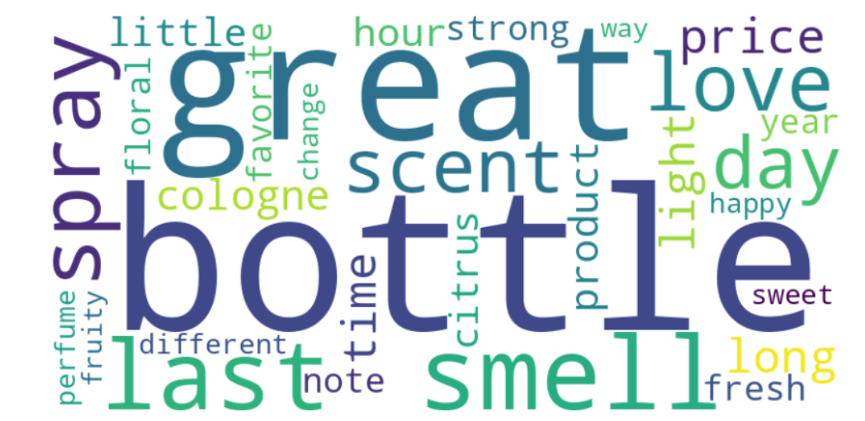
A Whiff of Data: Unveiling Perfume Insights from Customer Feedback
Scraped perfume products and reviews from Amazon.com
1700 perfumes
7000+ reviews.
Attributes Word Cloud
Removal of :
stop words
escape sequence characters
punctuations
Word tokenization
Lemmatization
Rejoin processed words

Slide 5
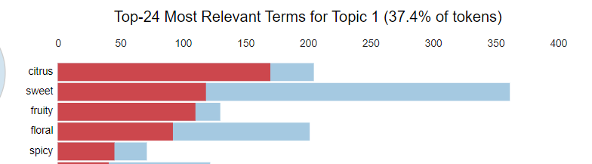
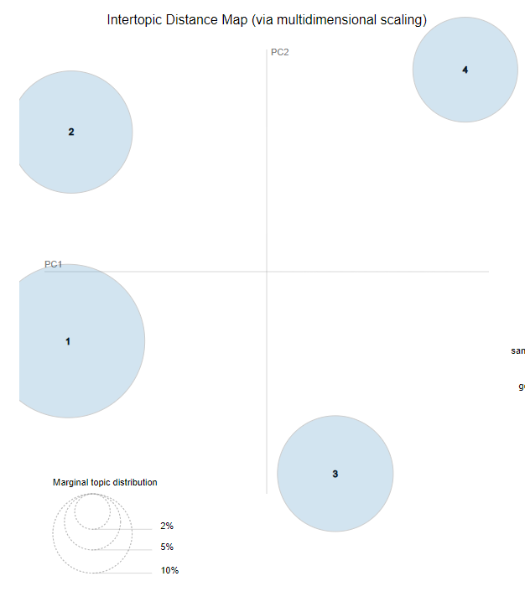
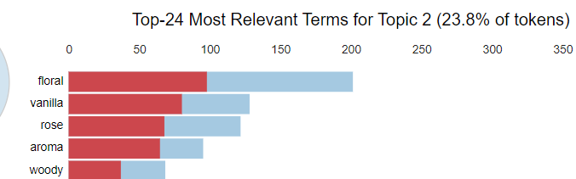
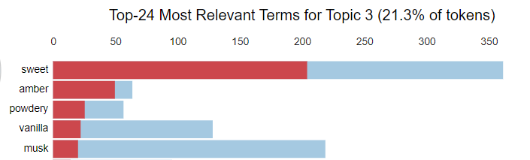
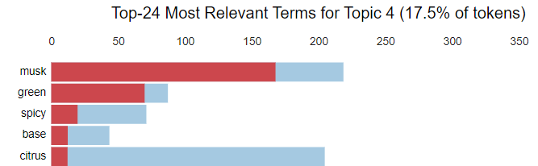
The Perfume Profiler:

Slide 6
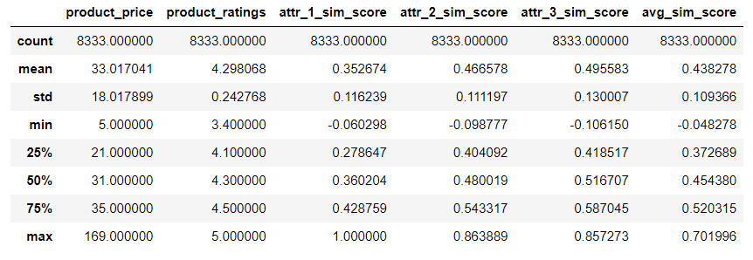
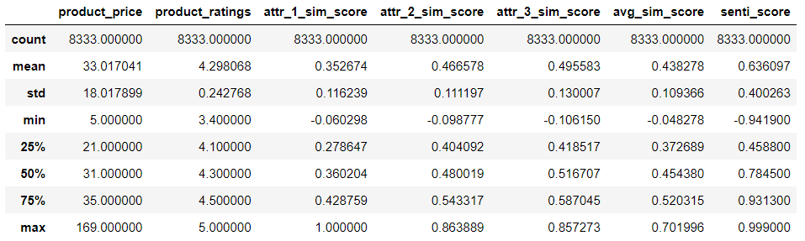
Inhale, Analyze, Excel
Word
Vector
Similarity
Word
Vector
Sentiment

Slide 7
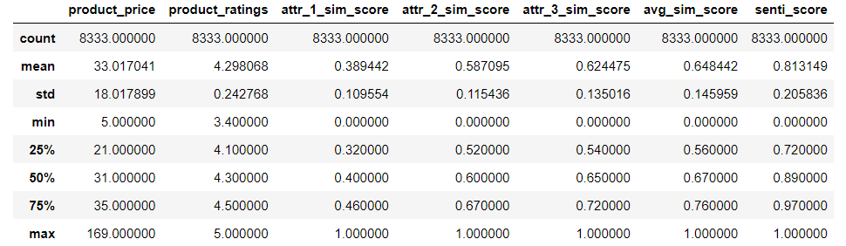
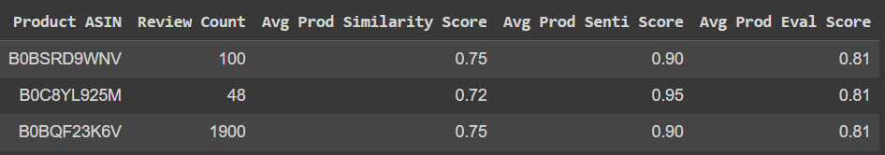
Inhale, Analyze, Excel
Evaluation
Score
Rating by Recommendation

Slide 8
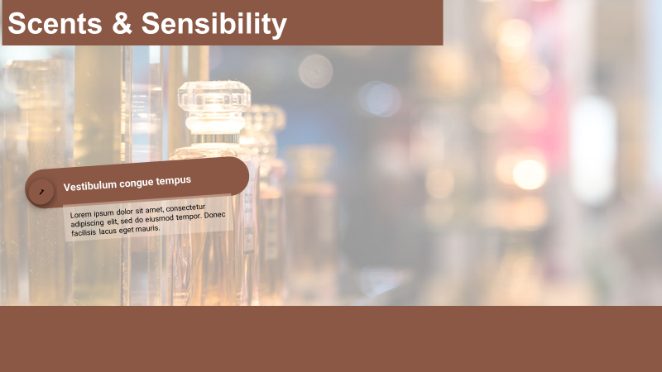
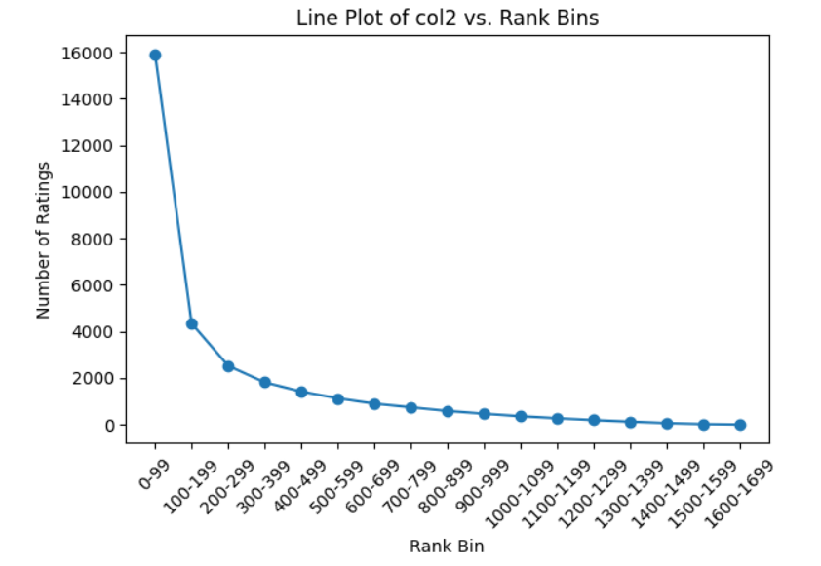
Scents & Sensibility
Why bother about the long tail?
Recalculate key attributes
Compare word-vec similarities
Take sentiment into account
Combine results to get hidden gems from the long-tail segment

Slide 9

Scents & Sensibility
Look at the data we have
1
What should these hidden gems do?
How can we evaluate Market Positioning?
2
Do customers value them the way they want to be valued?
3

Slide 10
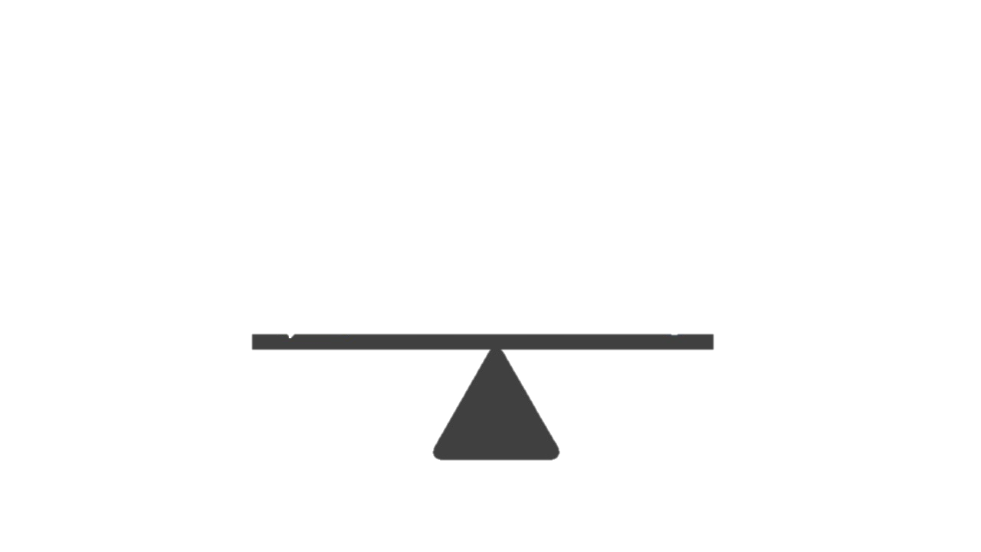
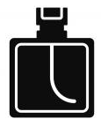
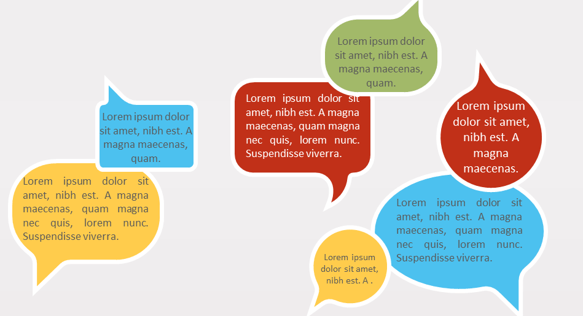
Scents & Sensibility
What should these hidden gems do?
Brand Description
Customer Reviews

Slide 11
Scents & Sensibility
We compare the similarity and lift of key attributes mentioned in the Product Description with the Reviews!
Product Description
Customer Reviews

Slide 12

The Aromas of Review Analysis
Open for Questions!
Notes:
We are developing a perfume recommendation system that utilizes customer review data from Amazon to generate personalized fragrance suggestions for users. This data-driven approach allows us to match fragrances to individuals' preferences and tastes based on patterns found in real customer experiences.

Slide 13
“"A fragrance tells a story about its wearer" ”
PAUL SMITH

